Slide 1
John 13:34-35
34"A new command I give you: Love one another. As I have loved you, so you must love one another.
35By this all men will know that you are my disciples, if you love one another."

Slide 2
Jesus Changes Everything
Jesus: The Foundation of Relationships

Slide 3
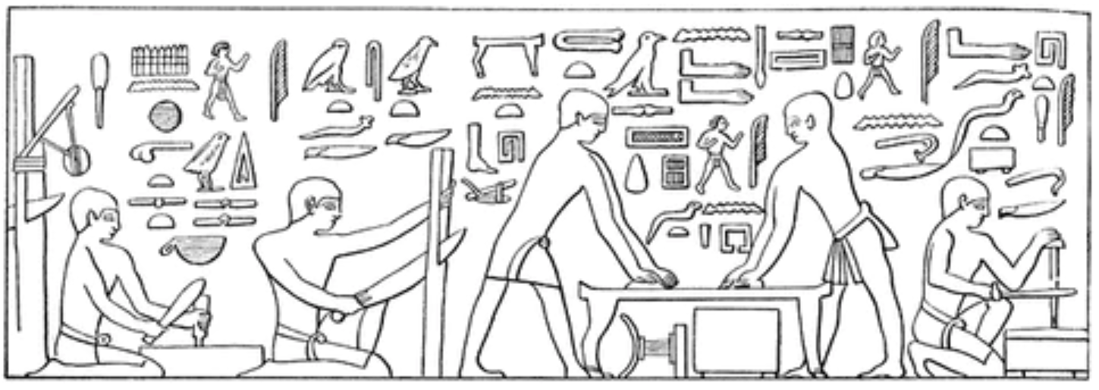
Love One Another
Jesus: The Foundation of Relationships
Early Egyptian woodworking c 2,400 BC

Slide 4
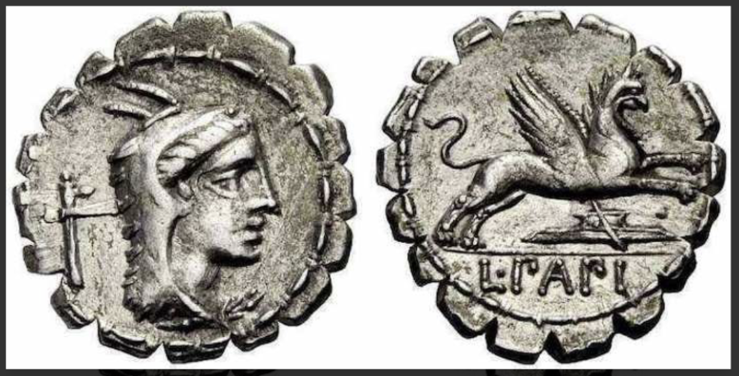
Love One Another
Roman silver denarius coin showing a smoothing plane, c.100 BC.

Slide 5
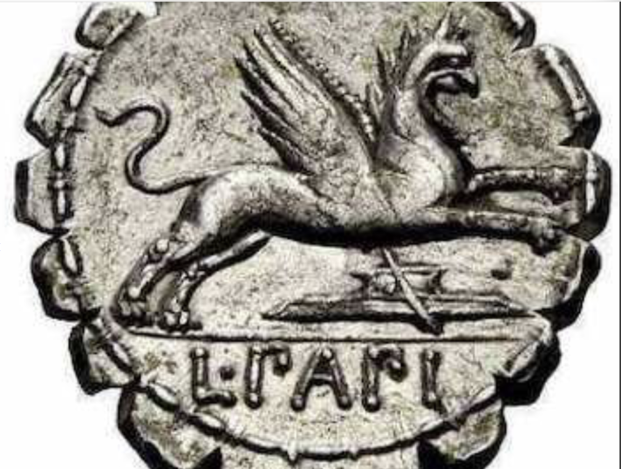
Love One Another
A smoothing plane under a griffin, c. 100 BC.

Slide 6
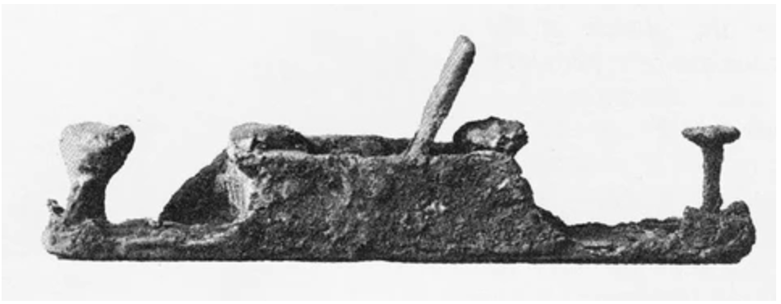
Love One Another
Plane found at Pompeii, dated 79 AD

Slide 7
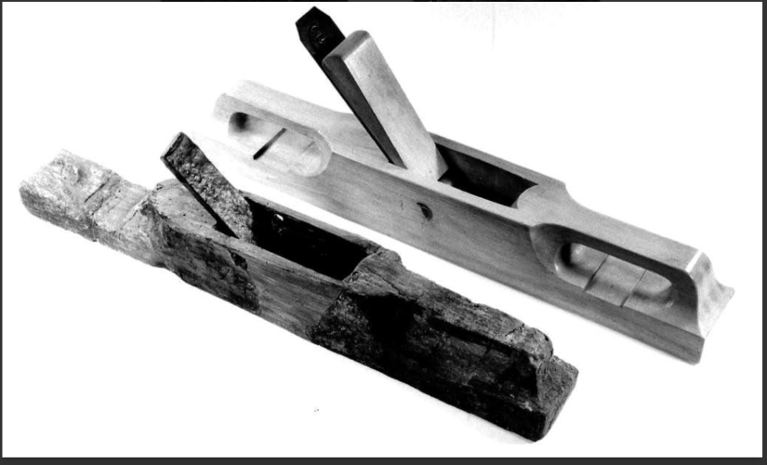
Love One Another
Plane found at Pompeii, dated 79AD
Roman plane found in Europe, together with a modern reconstruction (top).

Slide 8
Love One Another
Plane Renovation
Curious Research Took a Risk Invested $ Discouraged Trial and Error Effort, Work / Play cut / sand glue, epoxy oiling polishing

Slide 9
Love One Another
Plane Renovation | God Focus | Self Understanding | Loving Others
Curious Research Took a Risk Invested $ Discouraged Trial and Error Effort, Work / Play cut / sand glue, epoxy oiling polishing

Slide 10
Love One Another
Ringwood Community Church Connect Group
Melbourne School of Theology www.mst.edu.au
Wellspring Center www.wellspringcentre.org.au
Real Life: Real Love www.families.org.au/retreat

Slide 11
Love One Another
The Word (Jesus) gave life to everything that was created, and His life brought light to everyone. The light shines in the darkness and the Darkness cannot extinguish it.” John 1:4-5.
Recently
How does this work?
Challenge for this week

